Slide 1

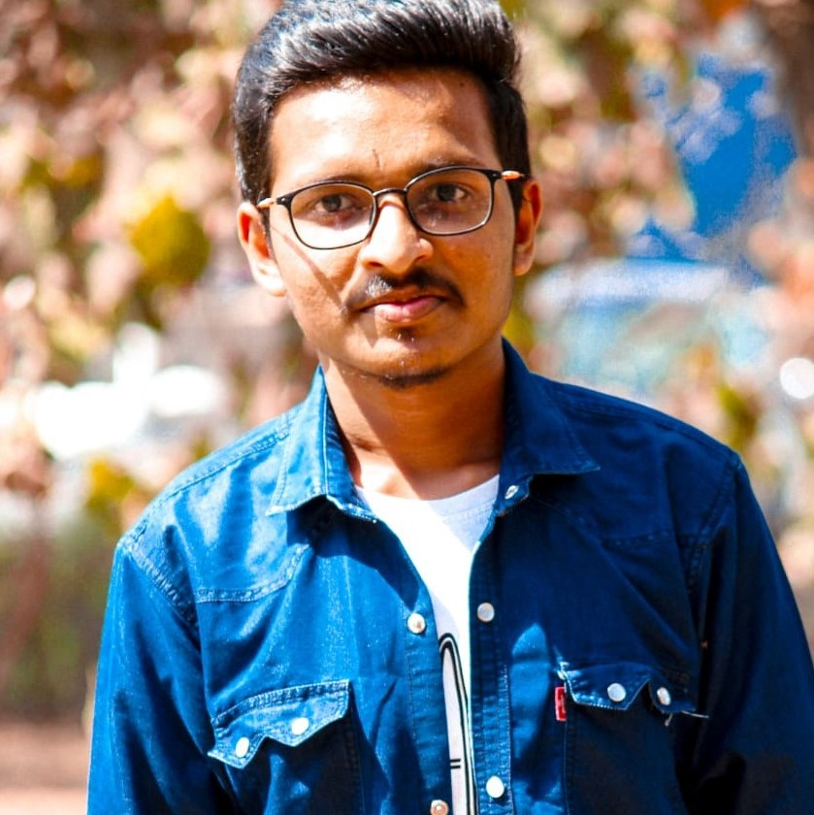

Introduction
Jeet N. Jadhav
Enrollment no:170450116008
College: SVMIT, Bharuch
email:(jnj220412@gmail.com )
Yagnesh Limbachiya
Enrollment no:170450116012
College: SVMIT, Bharuch
Email:(yagneshlimbachiya7@gmail.com)
Priyam Patel
Enrollment no:170450116035
College: SVMIT, Bharuch
Email:(priyampatel9911@gmail.com)

Slide 2
News Category Classification
The model trained on this dataset could be used to identify tags for untracked news articles or to identify the type of language used in different news articles.

Slide 3
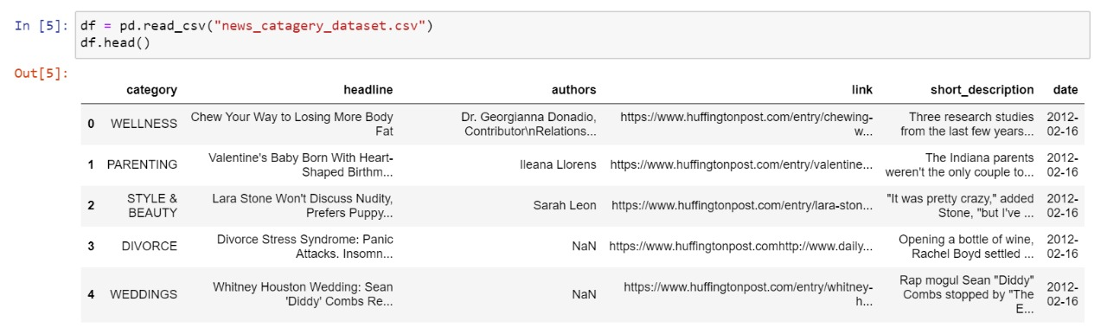
Data Processing

Slide 4
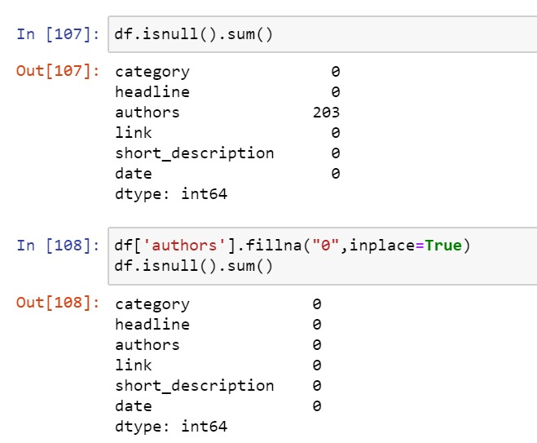

Slide 5
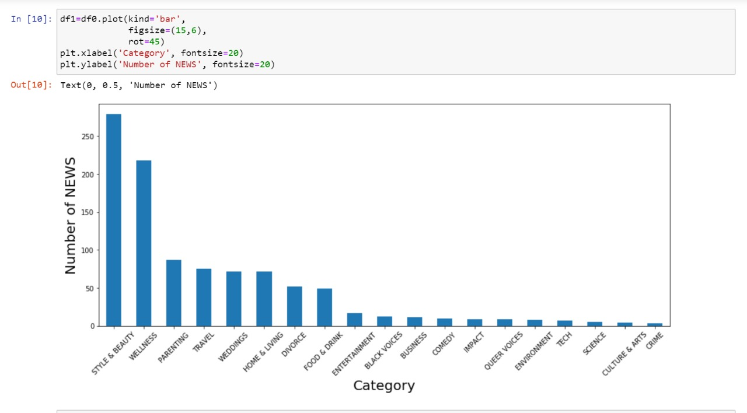
Data understanding

Slide 6
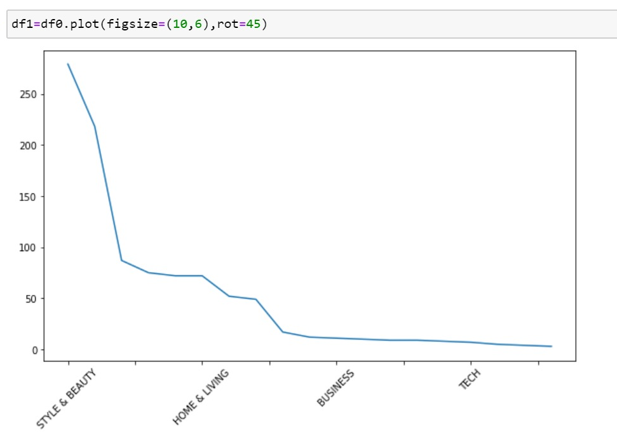
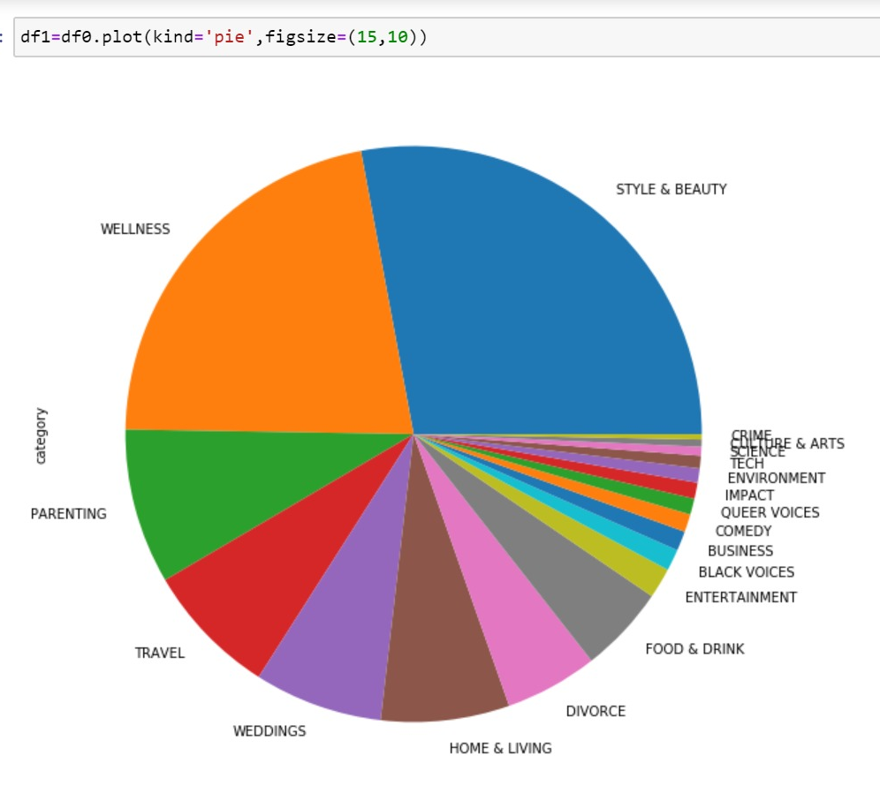

Slide 7
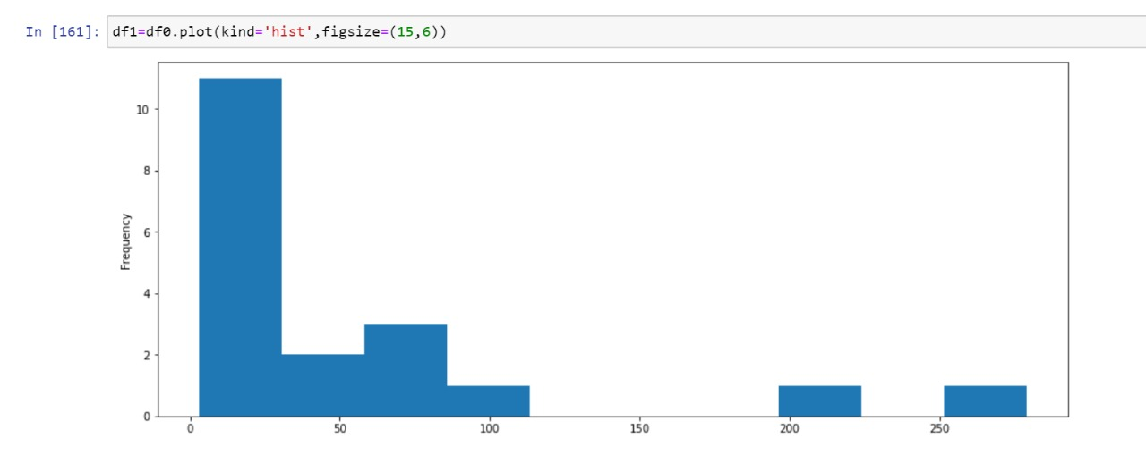

Slide 8
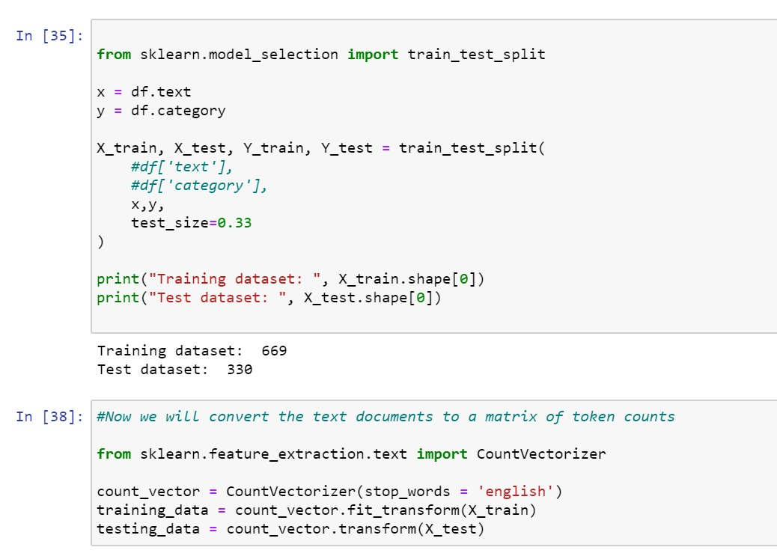
Machine Learning

Slide 9
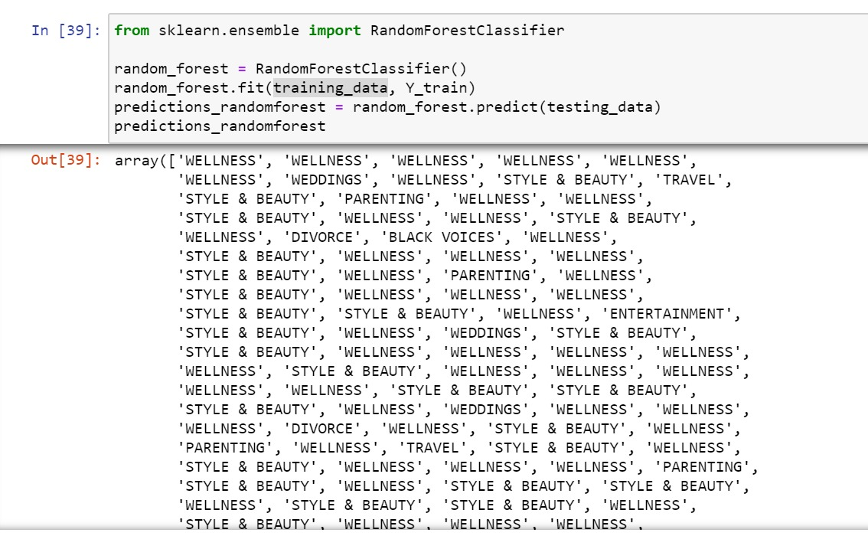
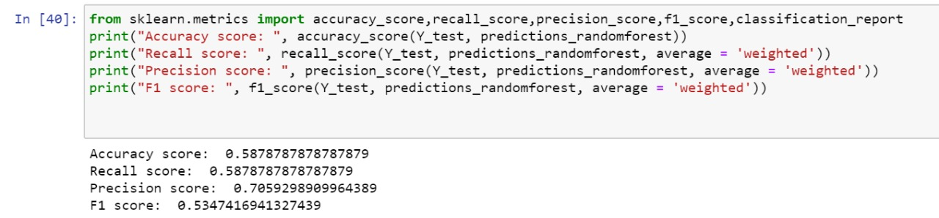

Slide 10
Thank You!

